Slide 1

Family Unity Reunion
Pace
Gordon
Simmons
Britton
Curtis
Lane
Gladney
Warren
Hunt
Johnson
Branch
Becton
Brown
Edwards
Jones
Gibbs
Neely
Sheffield
Hall
Williams
Readus
Curtis
Brock
2026

Slide 2

Family Reunion Gathering 2026
COMMITTEE MEMBERS
Co-Chairman: Louis J. Gladney @ (901) 736-5367 / gladlj@yahoo.com
Co-Chairman: Lawrence E. Gordon @ (901) 282-2084 / gordonl_1000@yahoo.com
Administrator/Communications: Kenneth D. Harris @ (901) 451-4308 / kennywayne84@gmail.com
Administrator/Communications: Teresa Gladney @ (901) 864-1827 / Teresagladney1@gmail.com
Treasurer: Gwendolyn Edwards @ (901) 412-0880 / gwenedw@att.net
Co-Chairman: Christopher E. Gordon (Honorary) @ R.I.H.
Advisors: Beverly L. Williams (254) 289-6741 / blwms44@yahoo.com & Mycha Y. Williams-Gladney (901) 736-5366 / mychawilliams@yahoo.com

Slide 3

Agenda Slides
Introduction
Itinerary
Reunion Package
Reunion Cost Per Person
Hotel Information
T-Shirt Sizes
Conclusion
Family Crest

Slide 4

Introduction
It gives me great joy, pleasure, and delight to announce the first “Family Reunion” of combined families - “A Gathering of Generations, Remembering Our Past, Living Today, and Embracing Our Future”. This year’s Family Reunion is a formal request by Aunt Mary on gathering not only the Gladney-Jones and Gordon-Lane families together; but Friends/Families she grew up with that we all consider as family. The Reunion affords us the opportunity as a family to gather, grow, love, share, reflect, and move forward together. So, mark your calendars, save your pennies, and join us in Memphis, Tennessee September 04 – 07, 2026. Please provide your personal information to Kenneth Harris and Teresa Gladney for accountability purposes and a photo of your loved ones(s) who has gone Home-to-Glory with their birth and deceased dates, and a list of the Elders (70 and Older) with their date of birth to Lawrence Gordon or Louis Gladney…….
If you have any questions and/or concerns, please contact either committee member above.

Slide 5
Itinerary
Come see, meet and greet all the family members you haven’t seen in a while or didn’t even know you had!!! We have a lot of great things planned and you don’t want to miss one minute of our 2026 Family Reunion!!!
September 04
- Meet and Greet @ Hilton Memphis (6:00 – 10:00 pm)
- T-Shirts and Wristbands Issued
September 05
- Canale Farms Picnic (10:00 am – 2:00 pm)
Main Event Entertainment (5:00 – 7:00 pm)
Manhattan Lounge (Adults Only)
September 06
- Church Services MBCC (11:00 am- 12:30 pm)
- Banquet @ Hilton (6:00 – 11:30 pm)
- Elders Appreciation Presentations

Slide 6

Reunion Inclusive Package (Deadline for reunion fees is July 31, 2026)
Welcome Reception @ Hilton Memphis Hotel in the Lakeview Meeting Rooms 1 & 2 (6:00-10:00 pm)
Hilton Memphis Hotel Banquet Room = Family Dinner: Sunday Best Attire (6:00 – 11:30 pm)
Family Picnic @ Canale Farms (10:00 am - 2:00 pm) https://www.canalefarms.com/
Family Photos
T-Shirts (Will be handed-out at Meet & Greet)
Main Event Entertainment
Disc Jockey
Shuttle/Party Bus (Provided from Hotel to Canale Farms)
Photographer

Slide 7
Reunion Cost Per Person
Inclusive of all taxes and gratuities:
Age 13 and Up = $165.00
Ages 5 - 12 = $80.00
Ages 4 & under = Complimentary

Slide 8
Hotel Information
The hotel accommodations chosen is the “Hilton Memphis Hotel”, located at 939 Ridge Lake Blvd, Memphis, Tennessee 38120. You will absolutely love this hotel; and plus, it has a 4.0 Star Rating. The room rates are $151.00 for single and double occupancy. Therefore, to secure the rooms for this price, we must reserve at least 15 rooms to get the group discount (Additional rooms can be added). To receive this discounted rate, please ensure you refer to the “Gladney-Jones, Gordon-Lane Family Reunion” upon booking your reservations. Make your reservations directly with “Hilton Memphis Hotel” by calling locally @ (901) 684-6664 or through the link they provided for our 2026 Reunion: https://www.hilton.com/en/book/reservation/deeplink/?ctyhocn=MEMPHHF&groupCode=96Z&arrivaldate=2026-09-04&departuredate=2026-09-07&cid=OM,WW,HILTONLINK,EN,DirectLink&fromId=HILTONLINKDIRECT
Please contact Gwendolyn Edwards (Treasurer) to place your name(s) on her Spreadsheet for tracking purposes after making your reservations. Once all particulars have been confirmed, Kenneth Harris Sr. and Teresa Gladney (Administrators) will notify you and forward the information through email or text. As far as any other dues/donations; Gwendolyn Edwards will be the Point of Contact. Therefore, refer to her when you want to make any payments other than the hotel.

Slide 9
T-Shirt Sizes (Deadline for T-shirt orders is June 30, 2026)
Child (S-L)
Adult (S, M, L, XL)
Adult (2X-4X)
Gwendolyn Edwards @ (901) 412-0880 / gwenedw@att.net
Notes:
Attended Bowdoin College in 1973 during the Civil Rights movement and acted as a liaison between the school’s African-American student body and administration
Received his juris doctor and a graduate of Harvard Law School in 1976
Worked at Rogers & Well corporate law firm after graduating from Harvard
Credits his tremendous work ethnic to his father
Lives by the quote of his father, “Focus on the things that you can control and the only thing that you can control is your performance.”
Joined AMEX in 1981 and rose to the ranks of CEO/Chairman is current position

Slide 10
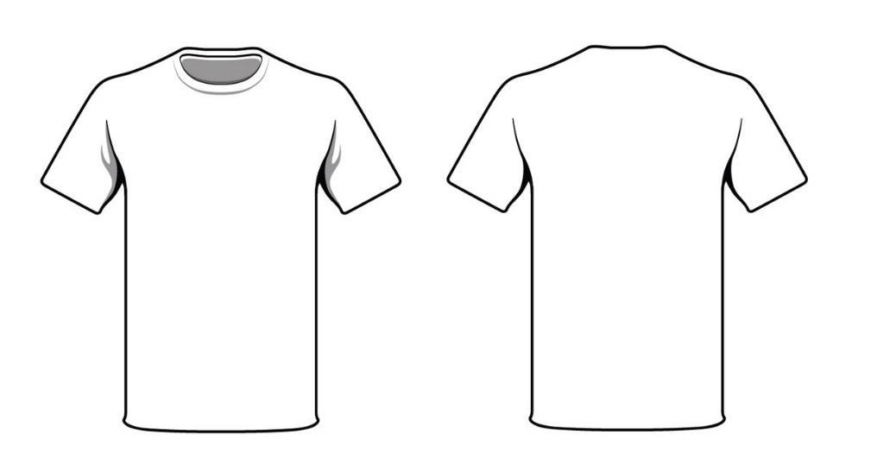







Est. 2025
Family Unity Reunion

Slide 11
Conclusion
As always, continue to pray for unity…and never, never, ever, let the “Chain” gather dust!!! Links will become weak and break…we’ll repair those that are broken and replace those that are gone; and as the Unity of the Family grows, we’ll continue to build and strengthen that chain. I’m looking forward to seeing all of you in Memphis, Tennessee, September 04-07, 2026!!! I have also created a Family Crest that symbolizes our family history, losses, struggles, and triumphs; while ensuring our family legacy continues to shine for generations to come.
Love & Prayers,
Louis J. Gladney

Slide 12



Family Crest
The Shield represents the body of our family; the Olive Branch represents the family linkage; the Cross represents our love for Christ; the Lion represents the strength of our family bond; the Year represents the creation of the Family Crest; the Colors represents freedom, faith, heaven, wealth, success, and wisdom, which represents our Fore-Fathers and Mothers.
For more details/updates, please visit our Facebook Account: Family Gathering Reunion 2026
Est. 2025

